Slide 1


Change and Project Management Toolkit Overview and Approach
Confidential
Created by ex-McKinsey, Deloitte & BCG Strategy Consultants

Slide 2
Introduction
This Change & Project Management Toolkit will help you create a holistic approach within your organization that tackles both project management and change management simultaneously. Indeed, we believe that one should not come without the other. On one hand, project management focuses on defining and implementing projects that will change your organization's structure, job roles, processes, and systems. On the other hand, change management focuses on helping individuals impacted by these changes to adapt and be successful. Far too often, we have noticed that many companies underestimate the importance of change management. The main problem is that if the employees and managers in your organization do not adopt and embrace the new changes, your projects will rarely achieve their expected return on investment.

Slide 3
Definition What is the main difference between Project Management and Change Management?
Business & Technical Change
Requires a Project Management approach to change the organization structure, job roles, processes, and systems
Current state
Transition
Target state
People change
Requires a Change Management approach to help individuals impacted by the business and technical changes in their company to adapt and be successful

Slide 4
Problem Projects are the lifeblood or organizations, but many projects fall short of expectations
Many of us have been there. You start off really excited about a project. And then in the middle of the journey, things start to fall apart. Deadlines are missed, deliverables don’t live up to expectations, and key stakeholders start to be dissatisfied.
By some estimates, Projects fail well over half the time.
But why do so many projects with such great potential end up as failures? Based on our experience working for tier-1 management consulting firms over the past 2 decades, we realized that many projects fall short of expectations because of:
Poor project management
Poor change management
Poor sponsorship
Unclear project objectives
Lack of project visibility
Unrealistic expectations
Communication gaps

Slide 5








Our Solution Our management consulting firm decided to create a Change & Project Management Toolkit that will help you increase the change and project management capabilities of your organization (or your client if you are a management consultant).
Best practices
Frameworks
What’s inside our Toolkits?
Advise from tier-1 management consultants
Tools
Real-life examples
Templates
Video Training
Step-by-step tutorials

Slide 6
Content The Toolkit includes 2 parts created by ex-Mckinsey, Deloitte and BCG management consultants
I. Change Management
II. Project Management

Slide 7
The Change & Project Management Toolkit includes frameworks, tools, templates, tutorials, real-life examples, best practices and video training to help you:
Change Management
Improve the change management capabilities of your organization with a simple and comprehensive 3-phase change management approach commonly used by Fortune 100 and global consulting firms: (I) Define the change management strategy, (II) Develop the Change Management Plans, (III) Implement, Track and Manage Progress
(I) Define your change management strategy: (1) Company strategy, (2) Required change to implement the strategy, (3) Business roadmap, (4) Company readiness for change, (5) Structure and size of the change management team, (6) Roles and responsibilities, (7) Guiding principles, (8) Lean change canvas, (9) Change impact assessment, (10) Change management objectives and levers (ADKAR Model)
(II) Develop your change management plans: (1) Overarching change management plan, (2) Communication plan, (3) Sponsorship plan, (4) Coaching plan, (5) Training plan, (6) Resistance management plan
(III) Implement, track and manage progress: (1) Governance, (2) Overarching change management plan status report, (3) Communication plan status report, (4) Sponsorship plan status report, (5) Coaching plan status report, (6) Training plan status report, (7) Resistance management plan status report, (8) Change reinforcement
Understand the top 12 change management frameworks and tools commonly used in most Fortune 500 companies: (1) Kotter’s 8 step Model of Change, (2) McKinsey 7S framework, (3) Burke-Litwin Change Model, (4) Prosci 3-phase process, (5) The Adkar Change Management Model, (6) Lewin's Change Management Model, (7) Change commitment curve, (8) Change personal transition curve, (9) Heart and mind human drivers, (10) Innovation adoption curve, (11) Maslow’s hierarchy of human needs, (12) Four stages of team development
Project Management
Improve the project management capabilities of your organization with a simple and comprehensive 3-phase project management approach commonly used by Fortune 100 and global consulting firms: (I) Build a business case and financial model, (II) Initiate the project, (III) Define and implement your project plan
(I) Build a business case and financial model to get your project approved by the executive committee: (1) Business opportunity & suggested solution, (2) Project objectives and key performance indicators (KPIs), (3) Project scope, approach and high-level plan, (4) Deliverables, activities & key success factors, (5) Strategic Alignment, (6) Value: project initial investment, project costs, additional revenue generated, cost savings, cash flows and net present value, (7) Ease of implementation
(II) Initiate your project: (1) Project charter, (2) Project challenges and key success factors, (3) RACI matrix, (4) Stakeholder analysis
(III) Define and implement your project plan: (1) High-level project plan, (2) Detailed project plan, (3) Project dashboard, (4) Parking lot, (5) Punch list, (6) Post-project evaluation report
Become a more agile organization with a 7-phase approach commonly used by Fortune 500 and global consulting firms: (1) Product Backlog, (2) Sprint Planning, (3) Sprint Backlog, (4) Sprint Execution, (5) Sprint Review, (6) Potentially Shippable Product Increment, (7) Retrospective

Slide 8



I. Change Management The first part of the Toolkit includes a summary of the top 12 change management frameworks and tools commonly used in most Fortune 500 companies, and a condensed and practical Change Management 3-Phase Approach to help you undertake the organizational change of your organization.
Phase I: Define the Change Management Strategy
Phase II: Develop the Change Management Plans
Phase III: Implement, Track and Manage Progress
Company strategy
Required change to implement the strategy
Business roadmap
Company readiness for change
Structure and size of the change management team
Roles & responsibilities
Guiding principles
Change Lean Canvas
Change impact assessment
Change management objectives and levers (ADKAR Model)
Overarching change management plan
Communication plan
Sponsorship plan
Coaching plan
Training plan
Resistance management plan
Governance
Overarching change management plan status report
Communication plan status report
Sponsorship plan status report
Coaching plan status report
Training plan status report
Resistance management plan status report
Stakeholder management
Change reinforcement
Top 12 change management frameworks and tools commonly used in most Fortune 500 companies
Kotter’s 8 step Model of Change
McKinsey 7S framework
Burke-Litwin Change Model
Prosci 3-phase process
The Adkar Change Management Model
Lewin's Change Management Model
Change commitment curve
Change personal transition curve
Heart and mind human drivers
Innovation adoption curve
Maslow’s hierarchy of human needs
Four stages of team development

Slide 9





II. Project Management The second part of the Toolkit includes a traditional Project Management 3-Phase Approach and an Agile approach to help you define and implement your projects effectively and efficiently
Traditional Approach
Phase I: Build a Business Case & Financial Model
Phase II: Initiate the Project
Phase III: Define and Implement your Project Plan
Project Description
Business opportunity & suggested solution
Project objectives and key performance indicators
Project scope, approach and high-level plan
Deliverables, activities & key success factors
Project Assessment
Strategic alignment
Value (Revenue, Costs, Net present value, ROI, etc.)
Ease of implementation
Project charter
Project challenges and key success factors
RACI matrix
Stakeholder analysis
High-level project plan
Detailed project plan
Project dashboard
Parking lot
Punch list
Post-project evaluation report
Agile Approach
Product Backlog
Sprint Backlog
Sprint Execution
Sprint Review
Potentially Shippable Product Increment
Retrospective
Sprint Planning

Slide 10
In the next slides, you’ll see a small preview of Phase I of our change management 3-phase approach
Phase I: Define the Change Management Strategy
Phase II: Develop the Change Management Plans
Phase III: Implement, Track and Manage Progress
Company strategy
Required change to implement the strategy
Business roadmap
Company readiness for change
Structure and size of the change management team
Roles & responsibilities
Guiding principles
Change Lean Canvas
Change impact assessment
Change management objectives and levers (ADKAR Model)
Overarching change management plan
Communication plan
Sponsorship plan
Coaching plan
Training plan
Resistance management plan
Governance
Overarching change management plan status report
Communication plan status report
Sponsorship plan status report
Coaching plan status report
Training plan status report
Resistance management plan status report
Stakeholder management
Change reinforcement
Top 12 change management frameworks and tools commonly used in most Fortune 500 companies
Kotter’s 8 step Model of Change
McKinsey 7S framework
Burke-Litwin Change Model
Prosci 3-phase process
The Adkar Change Management Model
Lewin's Change Management Model
Change commitment curve
Change personal transition curve
Heart and mind human drivers
Innovation adoption curve
Maslow’s hierarchy of human needs
Four stages of team development

Slide 11
Executive Summary - Change Lean Canvas
Change
Name
Enter the name of the change
Business Owner
Enter Business owner name
Change manager
Enter Change manager name
Submit
Date
Enter Change Canvas version & submit date
Describe the change that is happening
Why did we decide to do this change?
Who will be impacted by this change?
What will we do to prepare impacted stakeholders?
Insert what the employee, customer or user used to be able to do
Insert what the employee, customer or user will be able to do with this new change
Describe the rational behind the decision to do this change
Insert the different stakeholder groups impacted by this change
Insert what we will do to ensure proper adoption of the change (i.e. communication, training, pilot group,…)
When will they be impacted by this change?
What are the business outcomes we want to reach?
What are the business outcomes we are reaching?
What are the next steps?
Insert date
Insert the business outcomes we want to reach
When available, insert the business outcomes and their source
Include the next steps if any

Slide 12
Change Impact Assessment Scale
Low
Moderate
Medium
High
Extreme
Size of the change
1 team impacted
1 Business Unit
1 Division
Half of the Company
Every employee
Complexity of the change
The Complexity of the change depends on how we rated the impact intensity of the “People increase / reduction” change, “System” change, “Process” change, “Organization structure” change and “Culture” change (see below)
1.People increase / reduction change
There are low reductions in headcount predicted (~1 FTE), but natural attrition will account for the numbers
There are reductions in headcount predicted, but natural attrition will account for the numbers
There are reductions in headcount predicted but contractors will account for the numbers
There is a significant reduction in headcount predicted. Redeployment & redundancies will need to be factored in
There is a large headcount reduction required as part of this change. Significant effort will need to be invested in redeployment / redundancy
2.System change
Almost no change
Minor changes/enhancements to functionality in an existing system, that is low risk and noncritical
Major changes/enhancements to functionality in an existing system that is business critical but not customer facing
New technology is being introduced, but the key concepts and functionality are not too dissimilar to the old system. System is customer facing and has the potential to create external exposure if the change is managed poorly
New technology is being introduced which requires bringing a new way of thinking to an existing task. System is customer facing and has the potential to create external exposure if the change is managed poorly
3.Process change
Almost no change to current processes
Some change to current processes, however the change is only minor, and the processes are low risk, non-critical and have no impact to customers.
Significant change to several current processes, however the change is not complex, and processes are low risk, non-critical and have a low impact to customers or colleagues
Significant change to a number of business-critical processes, with some of the change being quite complex. Change will be negatively visible to colleagues, and customers if things go wrong.
Radical change to several core business processes. Colleagues and external parties will need to take on new skills to execute processes. Previously automated processes will become manual or vice versa
4.Organization structure change
There is almost no change to structural environment
There are minor changes to team structure
There are some changes to team structure, which will bring a mixed reaction.
There are significant changes to team structure, which is likely to be disruptive and may be considered a negative change by many
There is significant change to structure. This change will be perceived negatively by most. There is a risk of staff attrition as a result
5.Culture change
Almost no culture change required
There are some aspects of the team culture that need to be changed to support this initiative
There is a significant cultural shift required in the impacted areas to support this change
There is a major cultural change across many teams required to support this change
Culture Change required in all impacted groups to support this initiative

Slide 13
In the next slides, you’ll see a small preview of Phase II of our change management 3-phase approach
Phase I: Define the Change Management Strategy
Phase II: Develop the Change Management Plans
Phase III: Implement, Track and Manage Progress
Company strategy
Required change to implement the strategy
Business roadmap
Company readiness for change
Structure and size of the change management team
Roles & responsibilities
Guiding principles
Change Lean Canvas
Change impact assessment
Change management objectives and levers (ADKAR Model)
Overarching change management plan
Communication plan
Sponsorship plan
Coaching plan
Training plan
Resistance management plan
Governance
Overarching change management plan status report
Communication plan status report
Sponsorship plan status report
Coaching plan status report
Training plan status report
Resistance management plan status report
Stakeholder management
Change reinforcement
Top 12 change management frameworks and tools commonly used in most Fortune 500 companies
Kotter’s 8 step Model of Change
McKinsey 7S framework
Burke-Litwin Change Model
Prosci 3-phase process
The Adkar Change Management Model
Lewin's Change Management Model
Change commitment curve
Change personal transition curve
Heart and mind human drivers
Innovation adoption curve
Maslow’s hierarchy of human needs
Four stages of team development

Slide 14
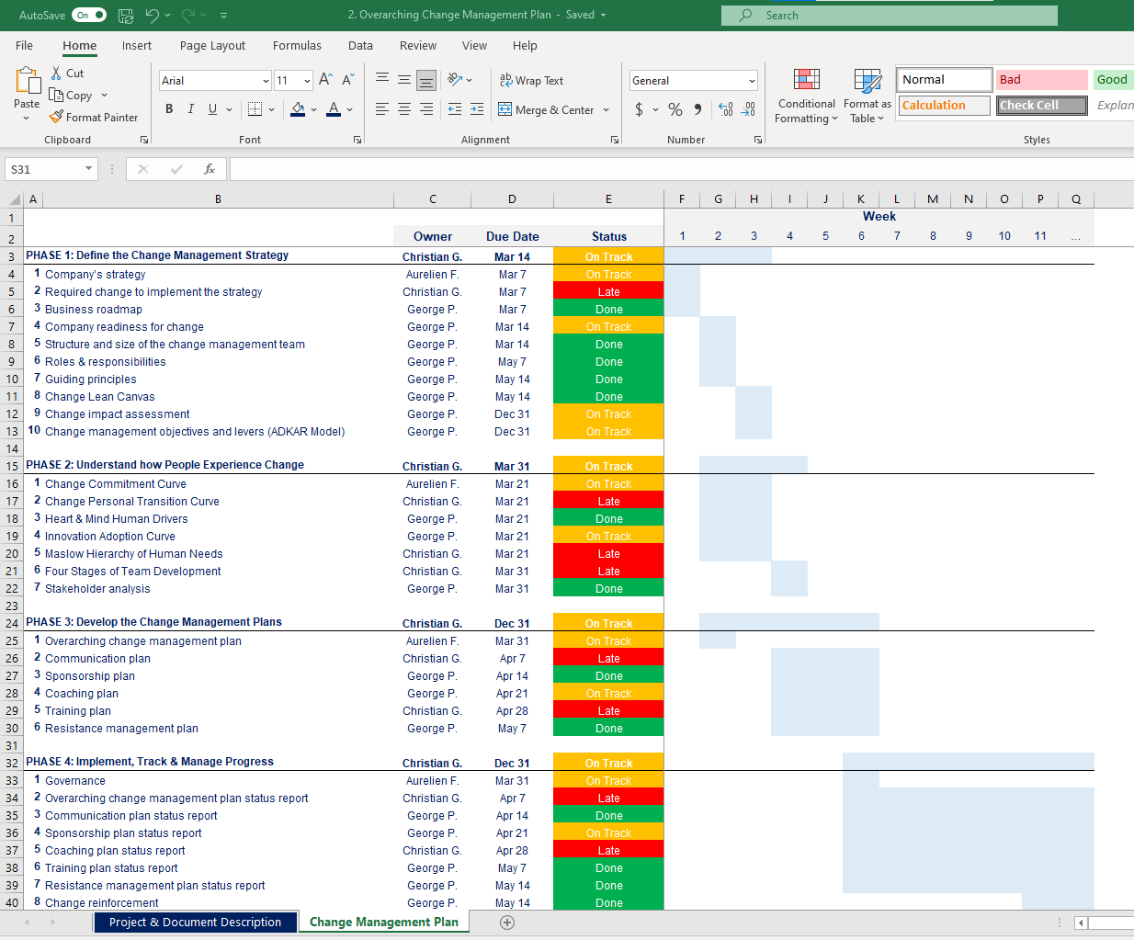
Overarching Change Management Plan Open the Excel document “Overarching Change Management Plan” for more details

Slide 15
Communication channel matrix The Channel Matrix below will give us a comprehensive list of the key communication channels to consider, from face-to-face meetings to newsletters.
Channels under direct control of management
Face-to-face options
Department or enterprise meetings
Group meetings
Focus groups
One-on-one meetings
Road show presentations (by project team)
Town Hall meetings
Team meetings
Brown bag lunches
Training courses and workshops
Alternate communication channels
Emails
Bulletin boards
Cafeteria postings
Change booklets
Corporate newsletters (feature section)
Demonstrations
Frequently asked questions (memos or newsletter feature)
Internal memos
Intranet pop-ups
Leaflets
Posters
Project newsletters
Videos
Voicemails
Webcasts
Website (Intranet)
Word of mouth
Channels not under direct control of management
Marketplace changes
Customer input
Ready-access to information
Employee rumors

Slide 16
In the next slides, you’ll see a small preview of Phase III of our change management 3-phase approach
Phase I: Define the Change Management Strategy
Phase II: Develop the Change Management Plans
Phase III: Implement, Track and Manage Progress
Company strategy
Required change to implement the strategy
Business roadmap
Company readiness for change
Structure and size of the change management team
Roles & responsibilities
Guiding principles
Change Lean Canvas
Change impact assessment
Change management objectives and levers (ADKAR Model)
Overarching change management plan
Communication plan
Sponsorship plan
Coaching plan
Training plan
Resistance management plan
Governance
Overarching change management plan status report
Communication plan status report
Sponsorship plan status report
Coaching plan status report
Training plan status report
Resistance management plan status report
Stakeholder management
Change reinforcement
Top 12 change management frameworks and tools commonly used in most Fortune 500 companies
Kotter’s 8 step Model of Change
McKinsey 7S framework
Burke-Litwin Change Model
Prosci 3-phase process
The Adkar Change Management Model
Lewin's Change Management Model
Change commitment curve
Change personal transition curve
Heart and mind human drivers
Innovation adoption curve
Maslow’s hierarchy of human needs
Four stages of team development

Slide 17
Overarching Change Management Plan - Status Report One-page summary
Significantly behind
Slightly behind
On track or completed
 | March | April | May | June | July | August | Sept | October
Understand the Company’s Strategy
Understand the Change required to implement the Strategy
Define your Change Management Strategy
Identify the Impact of the Change
Develop a Communication Plan
Develop a Sponsorship Plan
Develop a Coaching Plan
Develop a Training Plan
Develop a Resistance Management Plan
Implement, Track & Manage Progress
Reinforce the Change

Slide 18
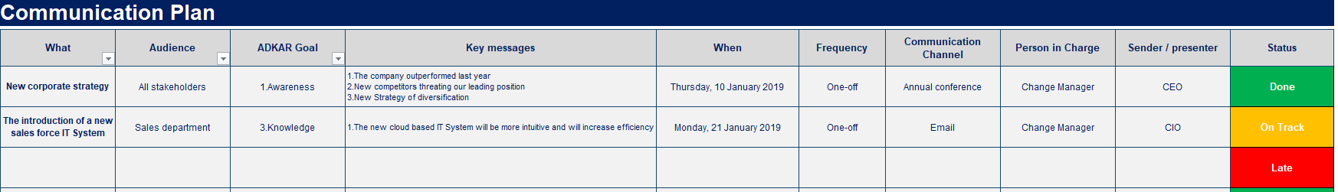
Communication Plan - Status Report Open the Excel document “Communication Plan” for more details
This structured communication plan will help us present the right messages, at the right time, in the right format, and from the right sender.

Slide 19
In the next slides, you’ll see a small preview of some change management frameworks and tools commonly used in most Fortune 500 companies
Phase I: Define the Change Management Strategy
Phase II: Develop the Change Management Plans
Phase III: Implement, Track and Manage Progress
Company strategy
Required change to implement the strategy
Business roadmap
Company readiness for change
Structure and size of the change management team
Roles & responsibilities
Guiding principles
Change Lean Canvas
Change impact assessment
Change management objectives and levers (ADKAR Model)
Overarching change management plan
Communication plan
Sponsorship plan
Coaching plan
Training plan
Resistance management plan
Governance
Overarching change management plan status report
Communication plan status report
Sponsorship plan status report
Coaching plan status report
Training plan status report
Resistance management plan status report
Stakeholder management
Change reinforcement
Top 12 change management frameworks and tools commonly used in most Fortune 500 companies
Kotter’s 8 step Model of Change
McKinsey 7S framework
Burke-Litwin Change Model
Prosci 3-phase process
The Adkar Change Management Model
Lewin's Change Management Model
Change commitment curve
Change personal transition curve
Heart and mind human drivers
Innovation adoption curve
Maslow’s hierarchy of human needs
Four stages of team development

Slide 20
Terms and Definitions according to Kotter
Change : The transition from a current state to a future state
Change Management : The practice of applying a structured approach to transition an organization from a current state to a future state to achieve expected benefits
Change Impact : How people, process, technology, and the workplace are affected during the transition from the current state to the future state.
Current State: The condition at the time the change is initiated.
Future State: The condition at the time when the benefits have been realized.

Slide 21
Description of the Kotter’s 8 step Model of Change
Kotter’s 8 Step Change Management Model is a process designed to help leaders successfully implement organizational change.
This model was developed by John P. Kotter, a Harvard Business School professor, and presented in his book “Leading Change,” which was based on years of research that showed that there’s only a 30% chance of effective organizational change implementation.

Slide 22
The Model walks you through the process of initiating, managing, and sustaining change in eight steps
Sustaining Change
8
Anchor the Changes in Corporate Culture
1
Create Urgency
Initiating Change
Kotter’s 8 step Model of Change
2
Form a Powerful Coalition
7
Build on the Change
6
Create Short-Term Wins
3
Create a Vision for Change
5
Remove Obstacles
4
Communicate the Vision
Managing Change

Slide 23
Step 1: Create Urgency
Description*
Potential Actions*
For change to happen, it helps if the whole company really wants it. Develop a sense of urgency around the need for change. This may help you spark the initial motivation to get things moving.
This isn't simply a matter of showing people poor sales statistics or talking about increased competition. Open an honest and convincing dialog about what's happening in the marketplace and with your competition. If many people start talking about the change you propose, the urgency can build and feed on itself.
Identify potential threats and develop scenarios showing what could happen in the future.
Examine opportunities that should be, or could be, exploited.
Start honest discussions and give dynamic and convincing reasons to get people talking and thinking.
Request support from customers to strengthen your argument.
*Source: “Leading Change” from John P. Kotter

Slide 24
McKinsey Seven-S Purpose
The McKinsey 7-S framework maps a constellation of interrelated factors that influence an organization's ability to change. It will help you ensure that:
All parts of your Organization are aligned and work in harmony.
Your organization is well organized to achieve its Vision and Strategic Goals.
The McKinsey 7-S Framework was developed in the early 1980s by Tom Peters and Robert Waterman, two consultants working at the McKinsey & Company consulting firm.

Slide 25
McKinsey Seven-S Description (1/2)
Caption:
The 3 “Hard S”
The 4 “Soft S”
The Seven-S tool is based on the theory that an organization is not just “Structure”, but is comprised of seven elements distinguished by the “hard S” and “soft S”
Structure
The 3 “hard S”, Structure, Strategy, and Systems, are practical and easily identifiable. The 4 “soft S”, Skills, Staff, Style, and Shared Values, are somewhat less easily discerned and are less tangible
Strategy
System
Shared
Value
The Seven-S diagram depicts how each of the element influences, and is influenced by all of the other elements
Skill
Style
Continuously evolving and changing, the “soft S” are determined by the people at work in the organization and hence, are difficult to anticipate or to influence. Although subterranean in nature, they can and do have a great impact on the “hard S”
Staff

Slide 26
ADKAR Model Purpose
The ADKAR model was developed by Jeff Hiatt in 2003 and it was introduced as a practical tool by Prosci. The ADKAR Model will help us support individuals moving through change by identifying our change management objectives and levers.

Slide 27
ADKAR Model Description
ADKAR is an acronym
Knowledge
Desire
Ability
Awareness
Reinforcement
CHANGE

Slide 28




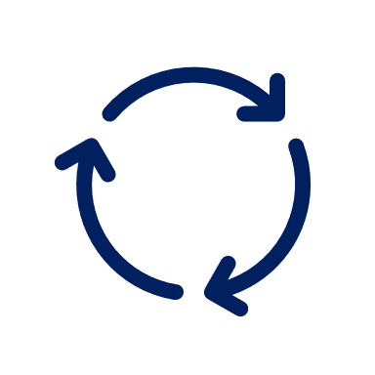
ADKAR Model Each one of the ADKAR Model 5 elements represents a particular objective that the Change Manager will try to achieve.
Awareness
of the need to change
Desire
to participate and support the change
Knowledge
of how to change (and what the change looks like)
Ability
to implement the change on a day-to-day basis
Reinforcement
to keep the change in place

Slide 29
In the next slides, you’ll see a small preview of Phase I of our traditional project management 3-phase approach
Traditional Approach
Phase I: Build a Business Case & Financial Model
Phase II: Initiate the Project
Phase III: Define and Implement your Project Plan
Project Description
Business opportunity & suggested solution
Project objectives and key performance indicators
Project scope, approach and high-level plan
Deliverables, activities & key success factors
Project Assessment
Strategic alignment
Value (Revenue, Costs, Net present value, ROI, etc.)
Ease of implementation
Project charter
Project challenges and key success factors
RACI matrix
Stakeholder analysis
High-level project plan
Detailed project plan
Project dashboard
Parking lot
Punch list
Post-project evaluation report
Agile Approach
Product Backlog
Sprint Backlog
Sprint Execution
Sprint Review
Potentially Shippable Product Increment
Retrospective
Sprint Planning

Slide 30
Lean Business Case Project name: Project description:
Strategic
Alignment
Yes
No
Net Present Value
$16.3M
Value
Ease of implementation
Low
Medium
High
Difficult
Intermediate
Easy
Project Sponsor
John Doe
Project Manager
John Doe
Change Manager
John Doe

Slide 31
Project Business Case Framework
Project Description
Project Assessment
1.Business opportunity & suggested solution
5.Strategic
Alignment
2.Project objectives and key performance indicators (KPIs)
6.Value
7.Ease of Implementation
3.Project scope, approach and high-level plan
4.Deliverables, activities & key success factors

Slide 32
In the next slides, you’ll see a small preview of Phase II of our traditional project management 3-phase approach
Traditional Approach
Phase I: Build a Business Case & Financial Model
Phase II: Initiate the Project
Phase III: Define and Implement your Project Plan
Project Description
Business opportunity & suggested solution
Project objectives and key performance indicators
Project scope, approach and high-level plan
Deliverables, activities & key success factors
Project Assessment
Strategic alignment
Value (Revenue, Costs, Net present value, ROI, etc.)
Ease of implementation
Project charter
Project challenges and key success factors
RACI matrix
Stakeholder analysis
High-level project plan
Detailed project plan
Project dashboard
Parking lot
Punch list
Post-project evaluation report
Agile Approach
Product Backlog
Sprint Backlog
Sprint Execution
Sprint Review
Potentially Shippable Product Increment
Retrospective
Sprint Planning

Slide 33
Project Charter (Template #1) Project name: Sponsor:
Problem statement
Insert in this box what business issue this project will address
Objective
Insert in this box the objective of this project
In-scope
Insert what is in-scope
Insert what is in-scope
Insert what is in-scope
Insert what is in-scope
Insert what is in-scope
Insert what is in-scope
Out-of-scope
Insert what is out-of-scope
Insert what is out-of-scope
Insert what is out-of-scope
Insert what is out-of-scope
Insert what is out-of-scope
Insert what is out-of-scope
Resources
Budget: Insert your own text
Project Manager: Insert your own text
Key Team Members: Insert your own text
Key Stakeholders: Insert your own text
Key milestones
Insert the name and target date of the milestone
Insert the name and target date of the milestone
Insert the name and target date of the milestone

Slide 34
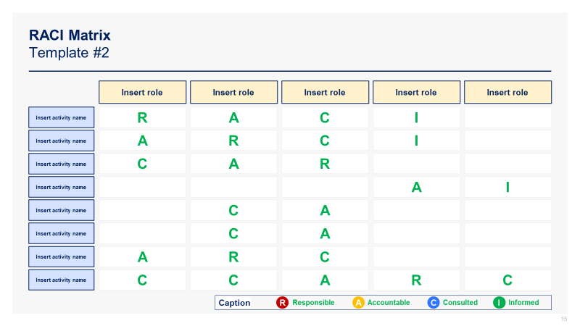
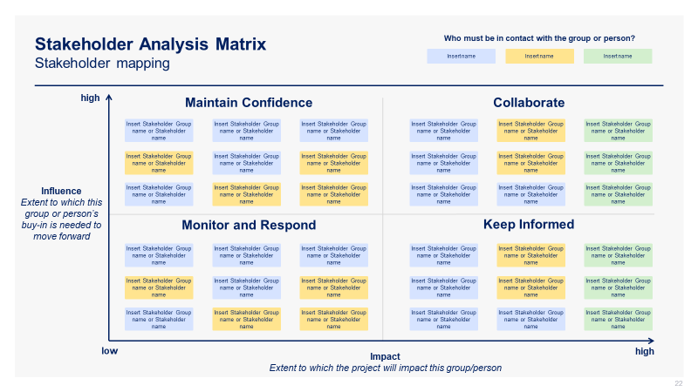
See below 2 additional screenshots
Screenshots
Responsibility Assignment (RACI) Matrix
Stakeholder Analysis Matrix

Slide 35
In the next slides, you’ll see a small preview of Phase III of our traditional project management 3-phase approach
Traditional Approach
Phase I: Build a Business Case & Financial Model
Phase II: Initiate the Project
Phase III: Define and Implement your Project Plan
Project Description
Business opportunity & suggested solution
Project objectives and key performance indicators
Project scope, approach and high-level plan
Deliverables, activities & key success factors
Project Assessment
Strategic alignment
Value (Revenue, Costs, Net present value, ROI, etc.)
Ease of implementation
Project charter
Project challenges and key success factors
RACI matrix
Stakeholder analysis
High-level project plan
Detailed project plan
Project dashboard
Parking lot
Punch list
Post-project evaluation report
Agile Approach
Product Backlog
Sprint Backlog
Sprint Execution
Sprint Review
Potentially Shippable Product Increment
Retrospective
Sprint Planning

Slide 36
Project Dashboard (Template #2) Project Name: Insert your own text Project Manager: Insert your own text
Overall Status
Time / Deadlines
Insert your own text - Insert your own text
Insert your own text - Insert your own text
Insert your own text - Insert your own text
Cost / Budget
Insert your own text - Insert your own text
Insert your own text - Insert your own text
Insert your own text - Insert your own text
Requirement / Quality
Insert your own text - Insert your own text
Insert your own text - Insert your own text
Insert your own text - Insert your own text
Key Past Milestones
Key Current Milestones
Key Future Milestones
✓
Insert Milestone
✓
Insert Milestone
✓
Insert Milestone
✓
Insert Milestone
✓
Insert Milestone
✓
Insert Milestone
✓
Insert Milestone
✓
Insert Milestone
✓
Insert Milestone

Slide 37
Parking Lot Description
IDEA/REQUEST | DELIVERABLE | TIMELINE | CONTACT PERSON | KEY ACTION
Insert your own text | Insert your own text | Insert your own text | Insert your own text | Insert your own text
Insert your own text | Insert your own text | Insert your own text | Insert your own text | Insert your own text
Insert your own text | Insert your own text | Insert your own text | Insert your own text | Insert your own text
Insert your own text | Insert your own text | Insert your own text | Insert your own text | Insert your own text
Insert your own text | Insert your own text | Insert your own text | Insert your own text | Insert your own text
Insert your own text | Insert your own text | Insert your own text | Insert your own text | Insert your own text
Insert your own text | Insert your own text | Insert your own text | Insert your own text | Insert your own text
Insert your own text | Insert your own text | Insert your own text | Insert your own text | Insert your own text
Insert your own text | Insert your own text | Insert your own text | Insert your own text | Insert your own text
Insert your own text | Insert your own text | Insert your own text | Insert your own text | Insert your own text
What would you like to do?
What would be the deliverables required to do it?
When do you need this done?
Who is accountable?
Key action to be taken to complete the request

Slide 38

In the next slides, you’ll see a small preview of the Agile approach
Traditional Approach
Phase I: Build a Business Case & Financial Model
Phase II: Initiate the Project
Phase III: Define and Implement your Project Plan
Project Description
Business opportunity & suggested solution
Project objectives and key performance indicators
Project scope, approach and high-level plan
Deliverables, activities & key success factors
Project Assessment
Strategic alignment
Value (Revenue, Costs, Net present value, ROI, etc.)
Ease of implementation
Project charter
Project challenges and key success factors
RACI matrix
Stakeholder analysis
High-level project plan
Detailed project plan
Project dashboard
Parking lot
Punch list
Post-project evaluation report
Agile Approach
Product Backlog
Sprint Backlog
Sprint Execution
Sprint Review
Potentially Shippable Product Increment
Retrospective
Sprint Planning

Slide 39




What is Agile?
DOING
AGILE
Agile comes to life through an unlimited number of practices
Defined by 12 principles
Described by 4 values
Agile is a Mindset
BEING
AGILE

Slide 40
Scrum methodology
STANDUP
15 min, Daily
SPRINT
1-4 Weeks
1. PRODUCT BACKLOG
2. SPRINT PLANNING
1 day
3. SPRINT BACKLOG
4. SPRINT EXECUTION
5. SPRINT REVIEW
6. POTENTIALLY SHIPPABLE PRODUCT INCREMENT
7. RETROSPECTIVE

Slide 41
Product backlog template
Product Backlog Item | Priority | User Story | Acceptance Criteria | Estimate | Dependencies
[Name of item] | [1, 2, 3, etc.] | As a [user], I want [goal/desired outcome], so that [reason] | [List of criteria that must be met for the item to be considered complete] | [Size of item in story points] | [Other items that this item depends on]
[Name of item] | [1, 2, 3, etc.] | As a [user], I want [goal/desired outcome], so that [reason] | [List of criteria that must be met for the item to be considered complete] | [Size of item in story points] | [Other items that this item depends on]
[Name of item] | [1, 2, 3, etc.] | As a [user], I want [goal/desired outcome], so that [reason] | [List of criteria that must be met for the item to be considered complete] | [Size of item in story points] | [Other items that this item depends on]
[Name of item] | [1, 2, 3, etc.] | As a [user], I want [goal/desired outcome], so that [reason] | [List of criteria that must be met for the item to be considered complete] | [Size of item in story points] | [Other items that this item depends on]
[Name of item] | [1, 2, 3, etc.] | As a [user], I want [goal/desired outcome], so that [reason] | [List of criteria that must be met for the item to be considered complete] | [Size of item in story points] | [Other items that this item depends on]

Slide 42

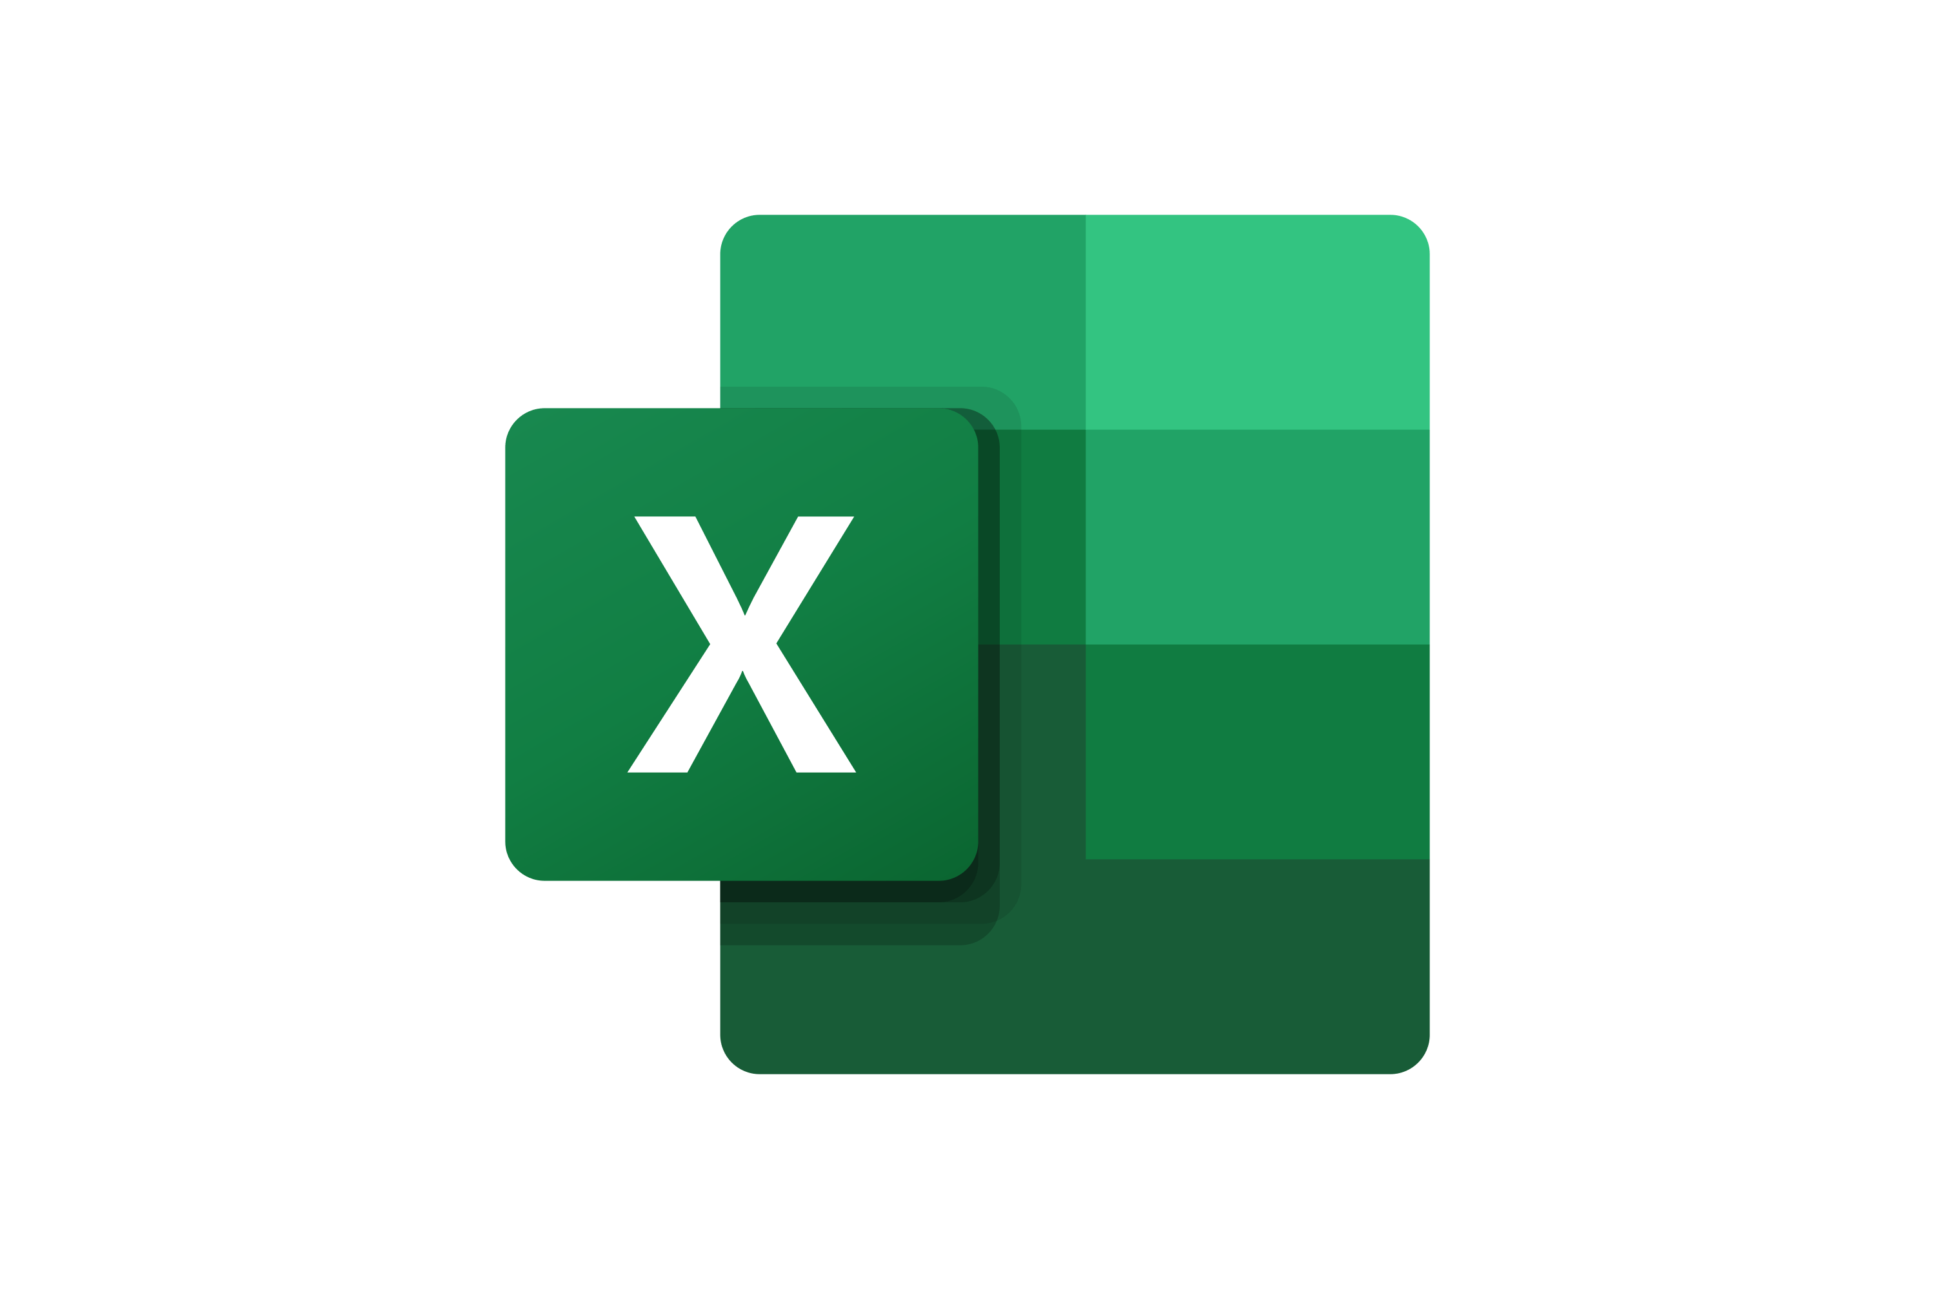



Structure of the Toolkit The Project & Change Management Toolkit includes 400 Powerpoint slides, 21 Excel sheets and 7 minutes of Video training categorized into multiple folders that you can download on your device immediately after your purchase.
400 editable Powerpoint slides*
21 editable Excel sheets*
36-min Video training
Change Management
Project Management Traditional Approach
Project Management Agile Approach
I. Define the Change Management Strategy
II. Develop the Change Management Plans
I. Build a Business Case & Financial Model
II. Initiate the Project
7-step Agile Approach
III. Implement, Track & Manage Progress
IV. Top 12 change management frameworks and tools
III. Define and Implement your Project Plan
*Please note that the number of PowerPoint slides and Excel sheets listed is the number of unique slides and sheets. For example, a PowerPoint slide that has been duplicated to facilitate our clients’ understanding only counts for 1 slide.

Slide 43









Key Benefits of our Management Consulting Toolkits
Improve the growth & efficiency of your organization by leveraging Management Consulting Toolkits created by ex-McKinsey, Deloitte & BCG Consultants.
Make a great investment for your career & organization. It cost us US$8M+ over the past 10 years to create all our Toolkits. Get them for a fraction of this cost.
Get a competitive advantage. It’s like hiring Management Consultants to create all the practical Frameworks, Tools & Templates you need.
Get the job done quicker and never start from scratch again with our ready-made and fully editable Frameworks, Tools & Templates in Powerpoint & Excel.
Don't reinvent the wheel. We have already worked 30,000+ hours over the past 10 years to create all the Management Consulting Toolkits you need.
Improve the capabilities of your organization by learning how the Fortune 100 and Global Consulting Firms do it.
Decrease your costs. Hiring tier-1 Consultants for a project would cost you $300k+. Way more expensive than our Toolkits, which will last you a lifetime!
Become your organization’s subject matter expert and impress your stakeholders with world-class approaches to resolve common business problems.
Get free support and advice from our ex-McKinsey, Deloitte & BCG Management Consultants.

Slide 44
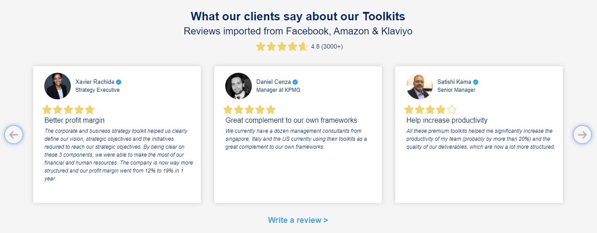
What our clients say about our Toolkits Reviews imported from Facebooks, Amazon and Klaviyo
See more reviews >

Slide 45

Join the 200,000+ Executives, Consultants & Entrepreneurs already leveraging our Business & Consulting Toolkits to improve the performance of their organization and boost their own career.
Trusted by small and large organizations
Customer satisfaction
4.8
Number of countries leveraging our Business & Consulting Toolkits
160+
Number of professionals leveraging our Business & Consulting Toolkits
200,000+
Daily rate of our ex-McKinsey, Deloitte and BCG Management Consultants
$3k-$4k

Slide 46
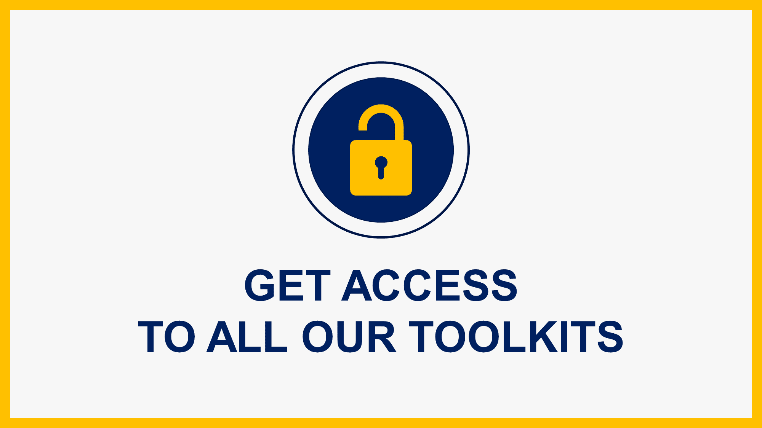
Interested in more than 1 Toolkit? Access all our Toolkits for half the price with our Gold Access
Gold Access
Click here to learn more

Slide 47
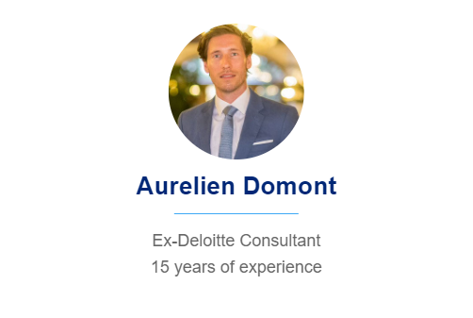
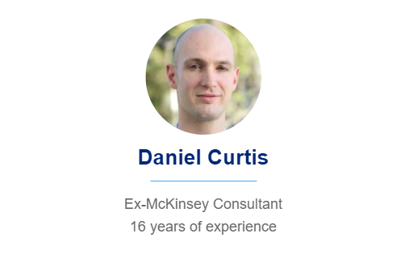
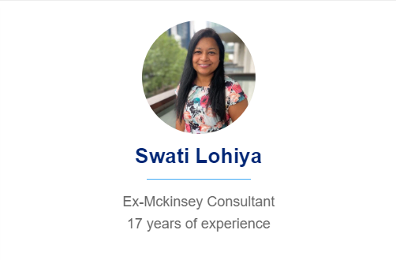
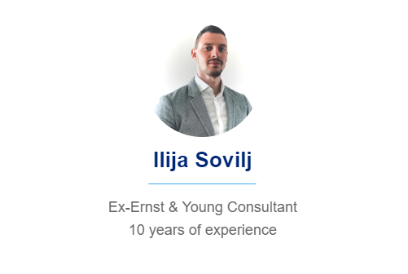
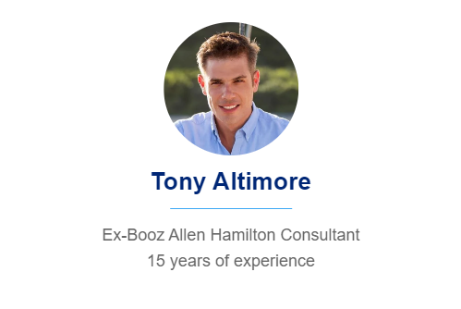
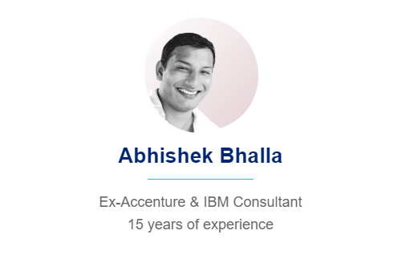
Need additional help on top of our Management Consulting Toolkits? Send us a brief and we’ll find you the right talent from our network of 500 tier-1 Management Consultants (the average daily rate is $3k)
Click here to send us a Project Brief

Slide 48
Thank you for your attention.
www.domontconsulting.com

